Slide 1
Computers are Blind
A lesson on Virtual Machines and program execution

Slide 2
Intended Learning Outcomes
Understand what is a virtual machine and what it is composed of
Learn the basic principles of stack, heap and stack frame
To know the difference between function call and function definition
Know how to simulate the computer execution of a simple program
Understand the program flow and how it changes during function calls and negative if statements

Slide 3
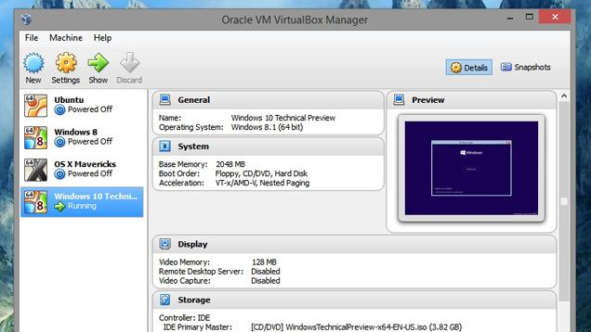

I’m a Virtual Machine!
No, I’m a Virtual Machine!

Slide 4
I’m a Virtual Machine!
No, I’m a Virtual Machine!

Slide 5
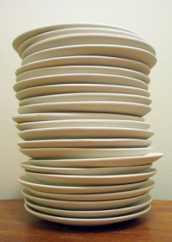
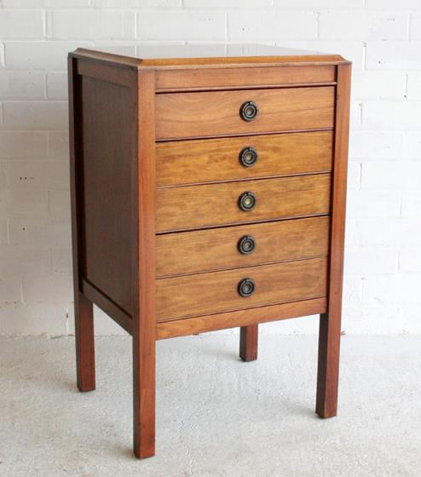
=
+

Slide 6
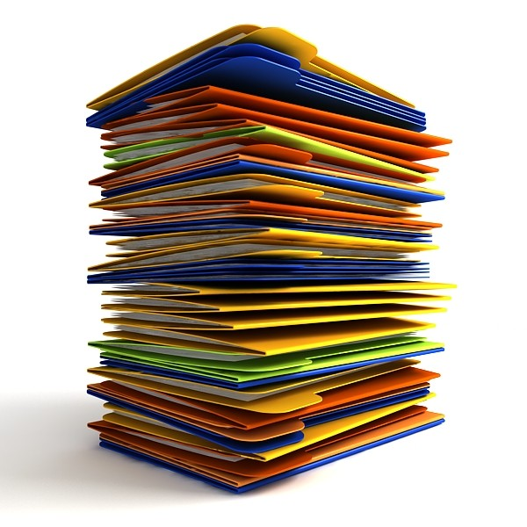
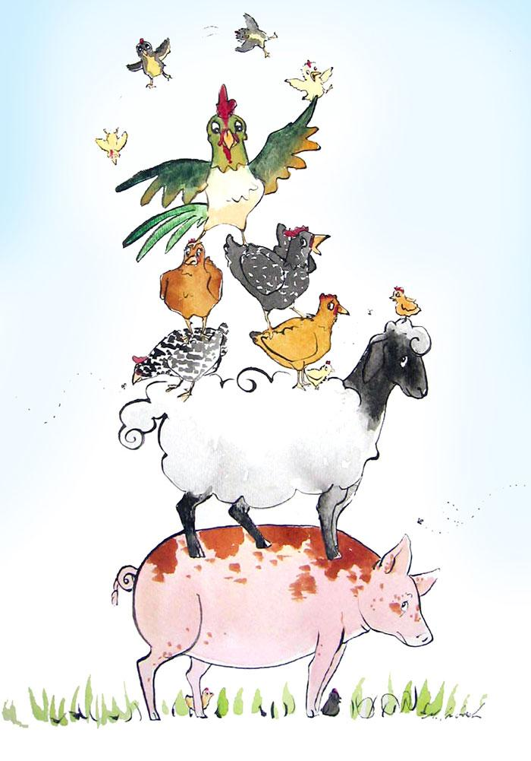
Stack
Stack frames

Slide 7
Heap
Heap addresses

Slide 8
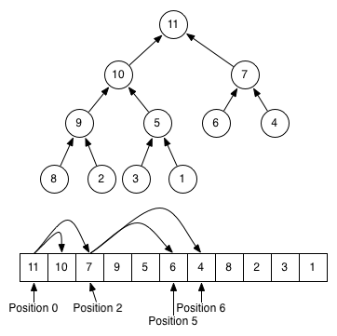
Heap

Slide 9

Function Definition
Function Call
A plumber is a tradesperson who specializes in installing and maintaining systems used for potable (drinking) water, sewage and drainage in plumbing systems. The term dates from ancient times, and is related to the Latin word for lead, "plumbum".^{[1][2]}

Slide 10
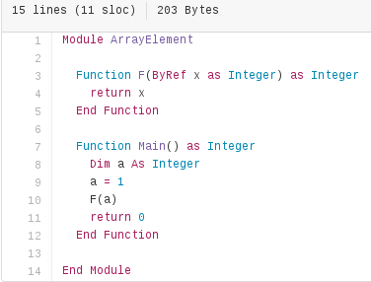
←objects
function calls →
Heap
Stack

Slide 11
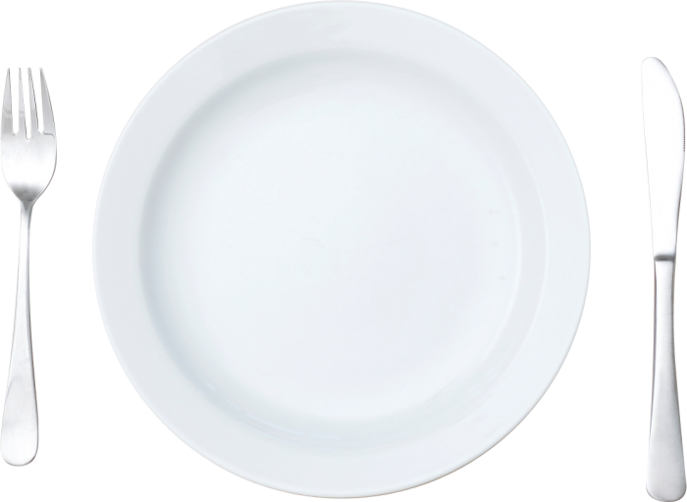
Stack Frame
Function name
variable names → heap addresses
Current line number

Slide 12
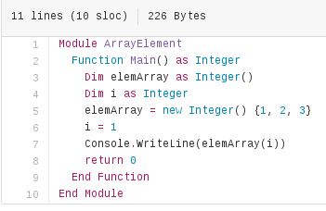
Stack frame
Heap
0
function name: Main()
variables:
i → 0
elemArray → 1
Current line number: 6
1
2

Slide 13
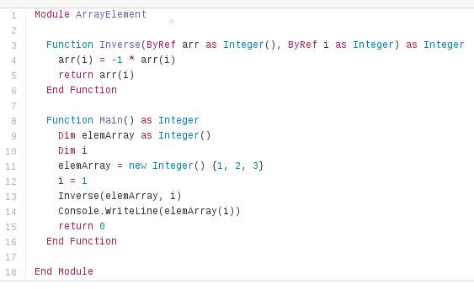

Slide 14
Programmer sees:

Slide 15
Computer sees:

Slide 16
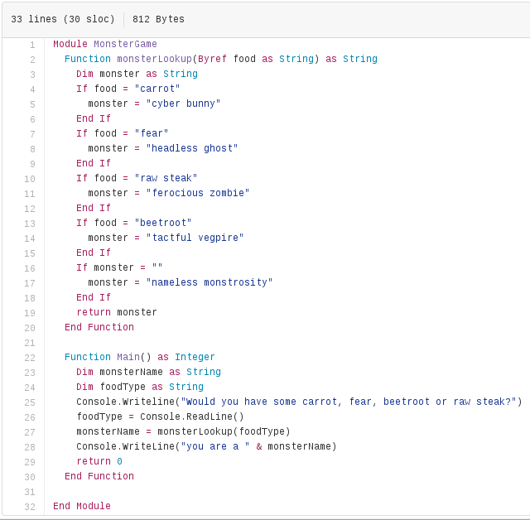
3 rules of program flow
1: Negative if statement
2: Function call
3: +1

Slide 17

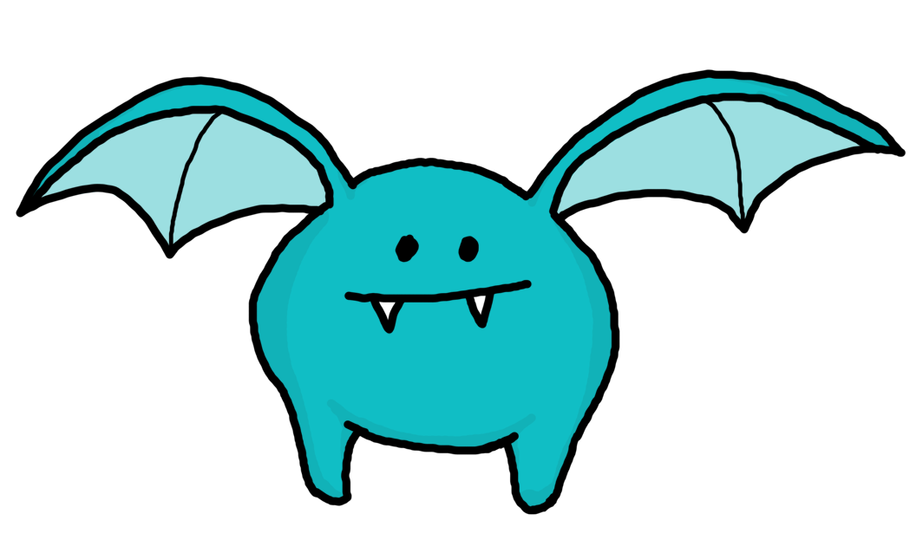

Let’s play a game now ...
Group in a team of 2 or 3 each
Follow the guidelines in your handout
You are given:
a stack frame
a heap
a program
some instructions
Execute the program

Slide 18
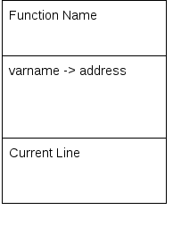
Stack Frame
function name: Main()
variables:
i → 0
elemArray → 1
Current line number: 6
=

Slide 19
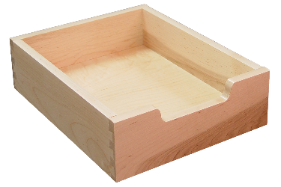
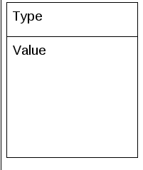
Object from the heap
Integer
=
1
1

Slide 20
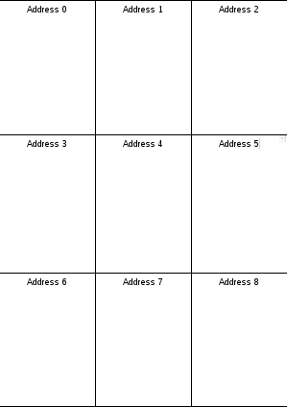
The heap
=

Slide 21
Which monster are you?
Give as an input to the program the food you like mostly among the following options
Execute the program using the stack, stack frame, heap and the instructions in your handout
Tell us your result when you are ready!

Slide 22
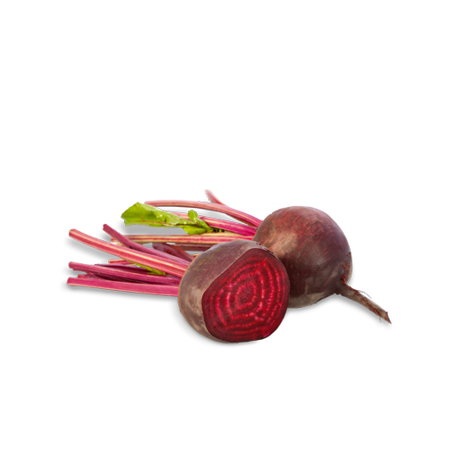
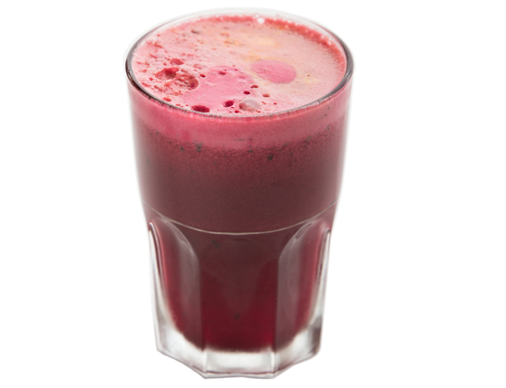
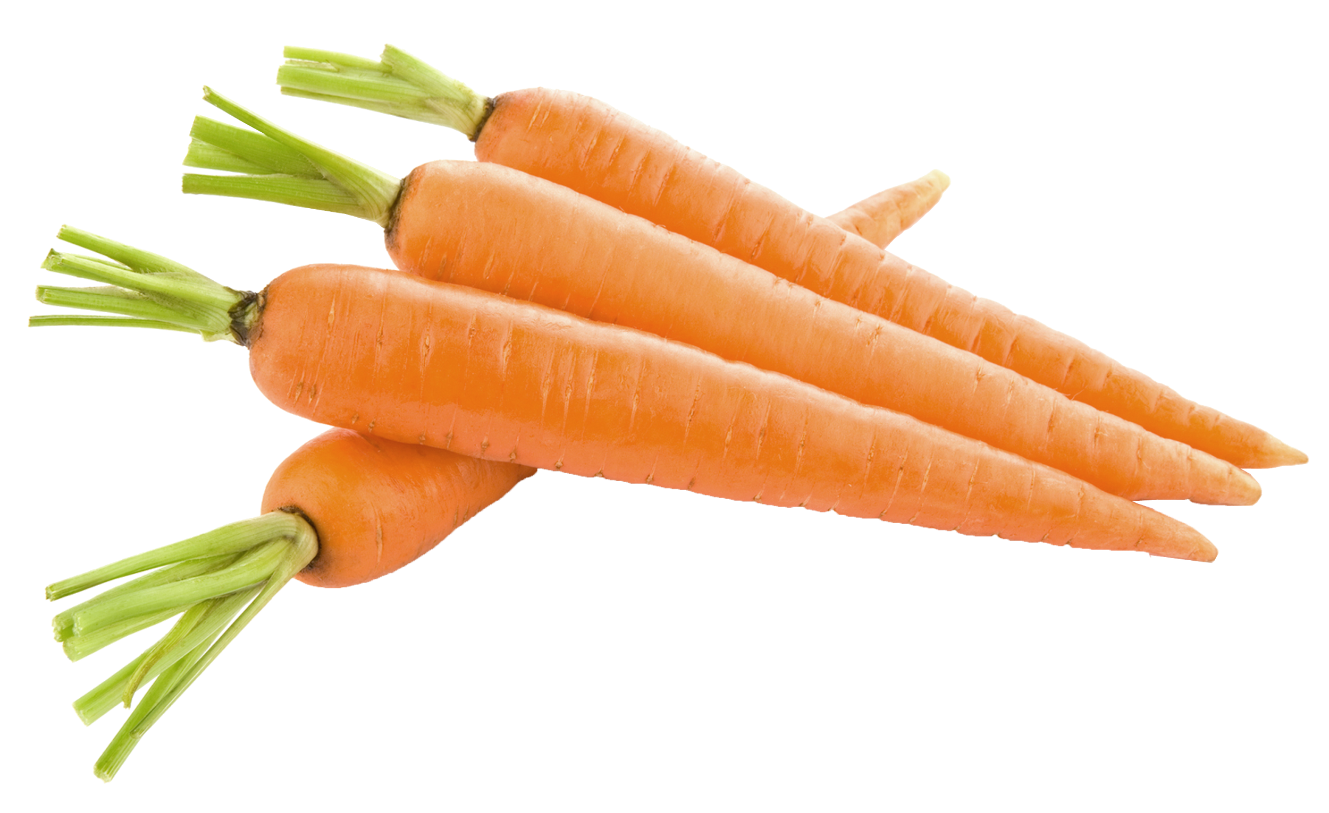
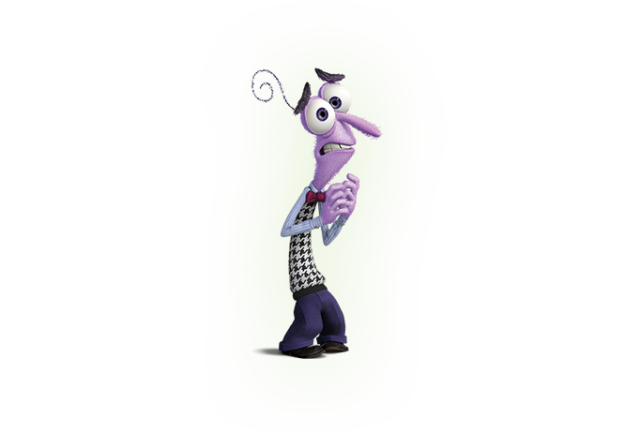
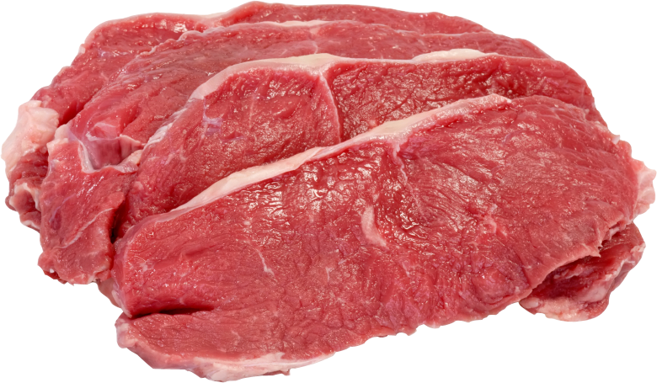
carrot
beetroot
What do you like to eat?
fear
raw steak

Slide 23
Which monster are you?

Slide 24
Discussion
What is a heap? When and how do we use it?
What is a stack?
What is a stack frame? What does a stack frame contain?
What is the difference between function call and function definition?

